Slide 1

App development with Constraint layout, Kotlin
& Firebase

Slide 2
Agenda
What’s new in constraint layout
Kotlin, fun tool for programmer
Machine learning with firebase

Slide 3
Layouts
Constraint layout - To build an expressive UI
Linear layout - Useful for straightforward layouts
Coordinate layout - To use material design tools
Frame layout - Better use for dynamic fragment and for single view layout
Relative layout - Good time to switch to constraint layout
Grid layout - Views need to be shown in grids ( try recyclerview)
Absolute layout - RIP

Slide 5
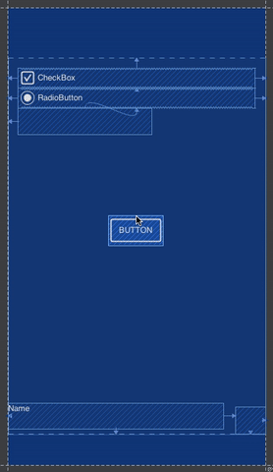
Constraint layout

Slide 6
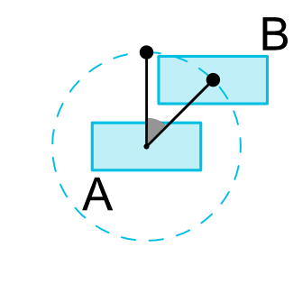
Circular Positioning
Position the corresponding view with the current view by some angle and distance - radius.

Slide 7
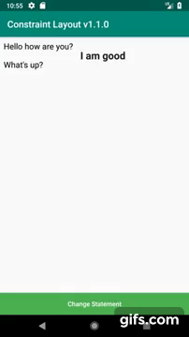
Barrier
A barrier adjust virtual guideline at runtime based on maximum size among various set of views.

Slide 8
Group
<android.support.constraint.Group android:id="@+id/group" android:layout_width="0dp" android:layout_height="0dp" android:visibility="gone" app:constraint_referenced_ids="view1,view2" />
A group acts on various set of views and set their visibility as VISIBLE, GONE or INVISIBLE.
It acts by taking view reference id.

Slide 9

Placeholder
It’s use to dynamically set content on screen where any view can be set to placeholder just by passing its id. If the view exists on same screen as placeholder than it’s visibility will automatically be set to gone.

Slide 10
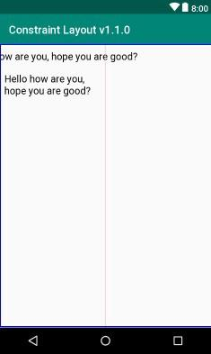
Dimension Constraint
It restrict view to be in the defined constraint even when view width/height is wrap content.

Slide 11
<Button android:layout_width="wrap_content" android:layout_height="wrap_content" android:text="Hello this is an example with constraint width" app:layout_constrainedWidth="true" app:layout_constraintLeft_toLeftOf="parent" app:layout_constraintRight_toRightOf="@+id/guideline_50"/>

Slide 12


Slide 13
Introduction
Kotlin is a statically typed language by Jetbrains.
It’s a JVM dependent language.
Available for multiplatform projects - JavaScript and Java.
Kotlin native for iOS app development.

Slide 14
Features of kotlin
Null Safety
Extension function
Higher Order Function
Default & Named Arguments
Data Class

Slide 15
Null Safety
val length
if(city != null) {
length = city.length
}
val length = city?.length

Slide 16
Extension Function
fun TextView.setCurrency(money: Double){
val numFormat = NumberFormat.getCurrencyInstance()
this.text = numFormat.format(money)
}
textView.setCurrency(100.50)

Slide 17
Higher Order Function
fun AppCompatActivity.networkCheck(
errorMessage: String = "Unable to connect, please try again later",
networkFun: () -> Unit) {
if(isNetworkAvailable) {
networkFun()
} else {
Toast.makeText(this, errorMessage, Toast.LENGTH_SHORT).show()
}
}
Default Argument

Slide 18

Default & Named Argument
fun updateAddress(city: String = "Hyderabad", state: String = "Telangana") { ..... }
updateAddress(city = "Mumbai", state = "Maharashtra")
updateAddress(state = "Maharashtra", city = "Mumbai")

Slide 19
Data Class
//If empty constructor needed
class Address {
val city: String = ""
val state: String = ""
val country: String = ""
}
data class Address(val city: String, val state: String, val country: String)

Slide 20


Slide 21
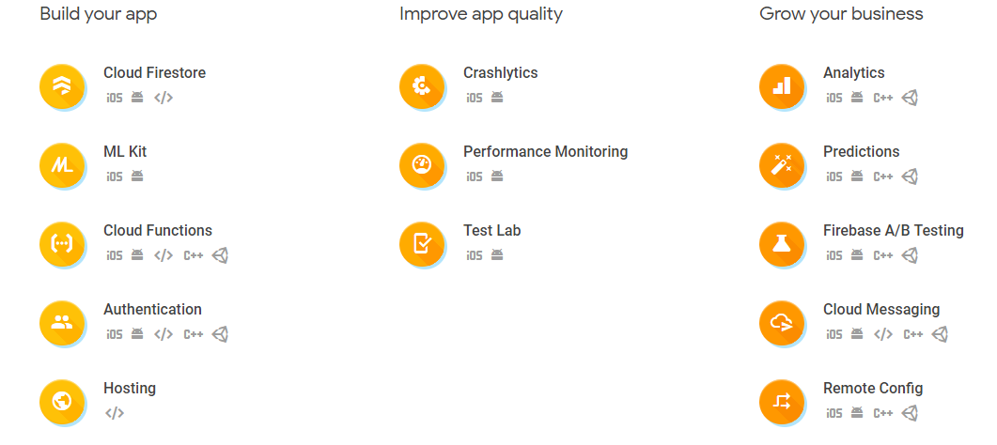
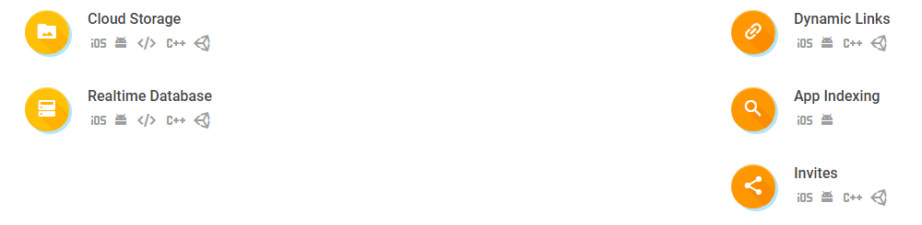

Slide 22
Cloud Firestore
A NoSQL database with a great querying capability.
Auto scale & Multi region database.
It’s based on Collection and Document.
Can build a serverless application using cloud firestore.

Slide 23
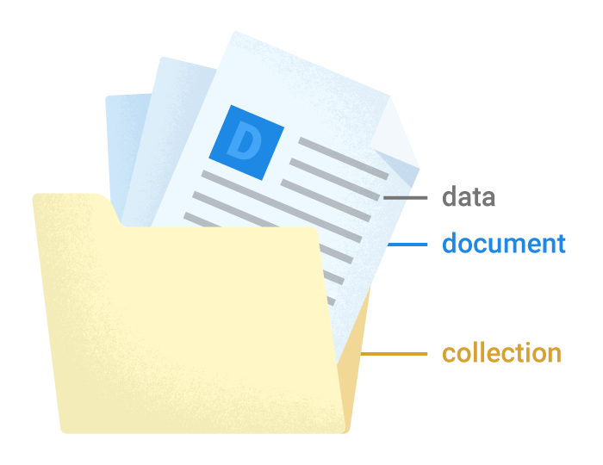
Collection & Document
Collection Collections are like a container which itself doesn’t store any data but contains document which in turn stores data.
Document It’s the smallest unit to store data in the database more set of data type are now supported with document

Slide 24


Slide 25
ML kit
ML Kit lets you to bring powerful machine learning features in your app whether it's for Android or iOS.
There's no need to have deep knowledge of neural network or model optimization to get started.

Slide 26
https://bit.ly/2s9T0W8

Slide 27
Landmark recognition |  | On Cloud
Text recognition | On Device | On Cloud
Image labeling | On Device | On Cloud
Face detection | On Device
Barcode scanning | On Device
Custom model inference - Tensorflow Lite | On Device

Slide 28
If ML Kit's APIs doesn’t cover your use cases, you can always bring your own existing TensorFlow Lite models.
Just upload your model to Firebase, and it will be taken care for hosting and serving it to your app.
ML Kit acts as an API layer to your custom model, making it simpler to run and use.

Slide 29
Recognize Text
val firebaseVision = FirebaseVisionImage.fromBitmap(bitmap)
val textDetector = FirebaseVision.getInstance().visionTextDetector
textDetector.detectInImage(firebaseVision).addOnCompleteListener {
task -> if (task.isSuccessful) {
for (block in task.result.blocks) {
print(block.text)
}
}
}

Slide 30
Face Detection
val options = FirebaseVisionFaceDetectorOptions.Builder() .setModeType(FirebaseVisionFaceDetectorOptions.ACCURATE_MODE) .setLandmarkType(FirebaseVisionFaceDetectorOptions.ALL_LANDMARKS) .build()
val detector = FirebaseVision.getInstance().getVisionFaceDetector(options) val firebaseVision = FirebaseVisionImage.fromBitmap(bitmap)
detector.detectInImage(firebaseVision).addOnCompleteListener { task -> if (task.isSuccessful) { for(face in task.result) { print(face.smilingProbability) } } }

Slide 31

Thank You
Pankaj Rai
https://medium.com/@pankaj.rai16 https://www.linkedin.com/in/pankajrai16/

